Slide 1

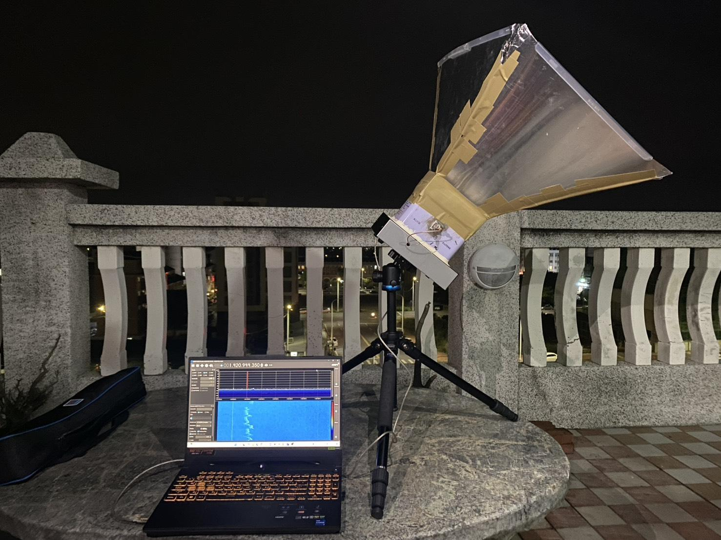
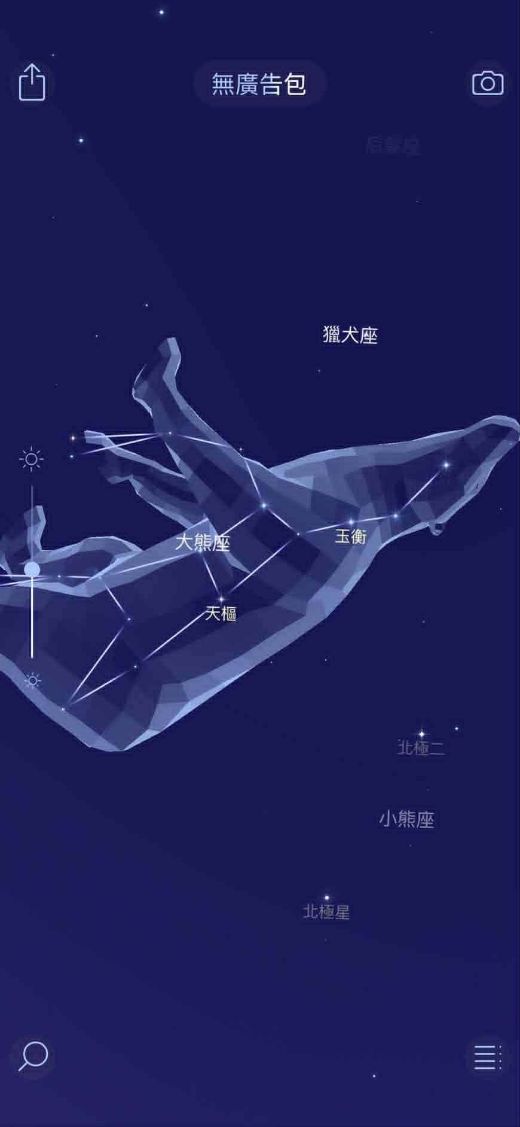
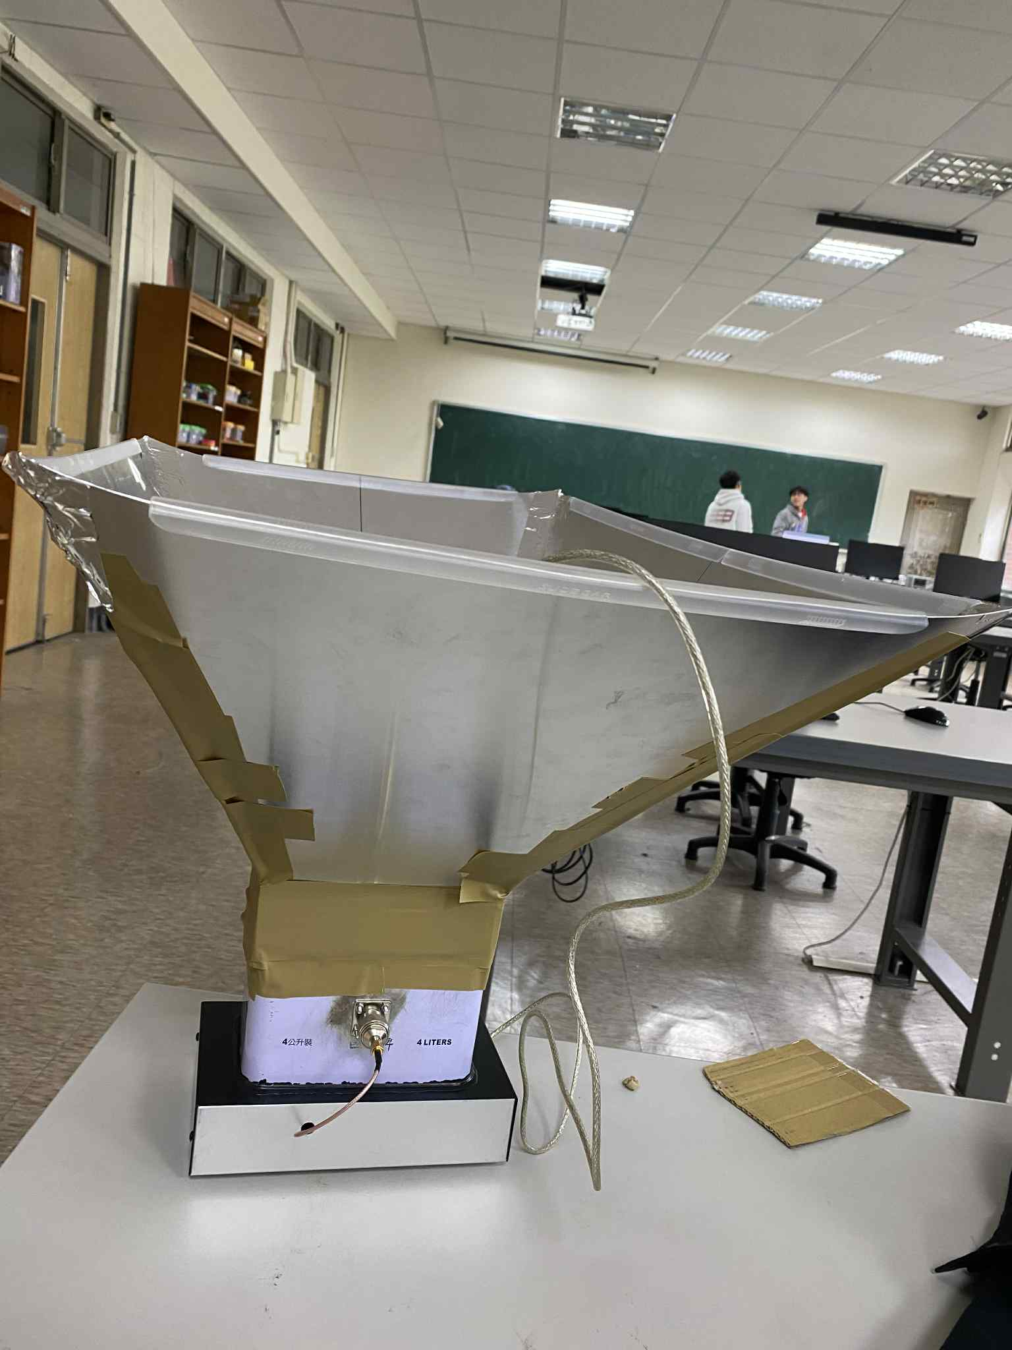
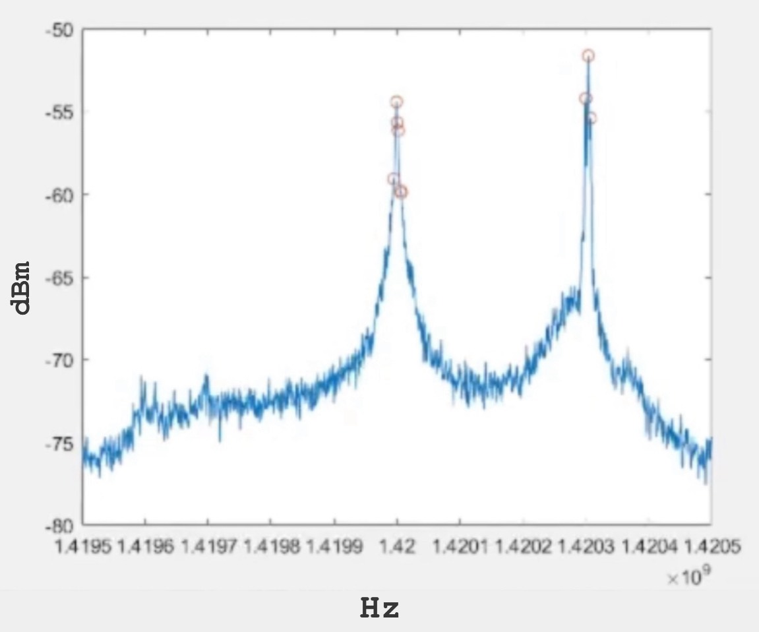
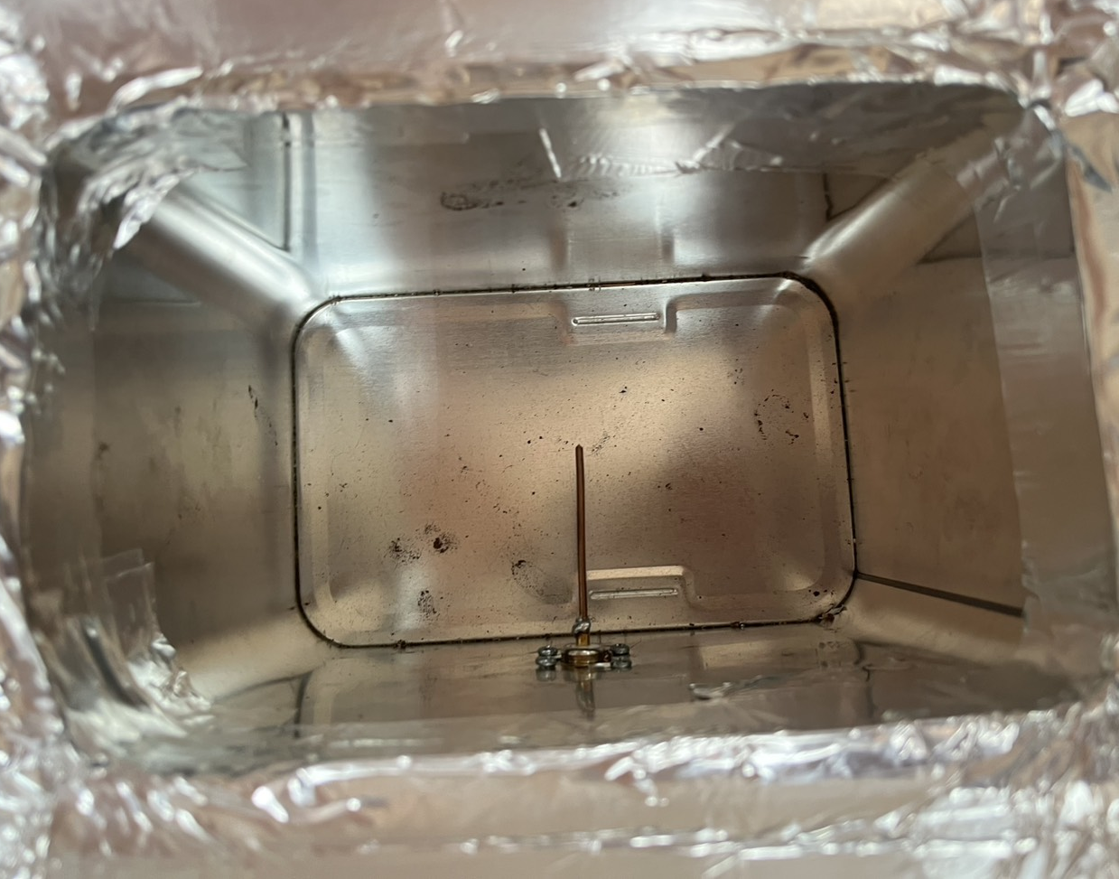
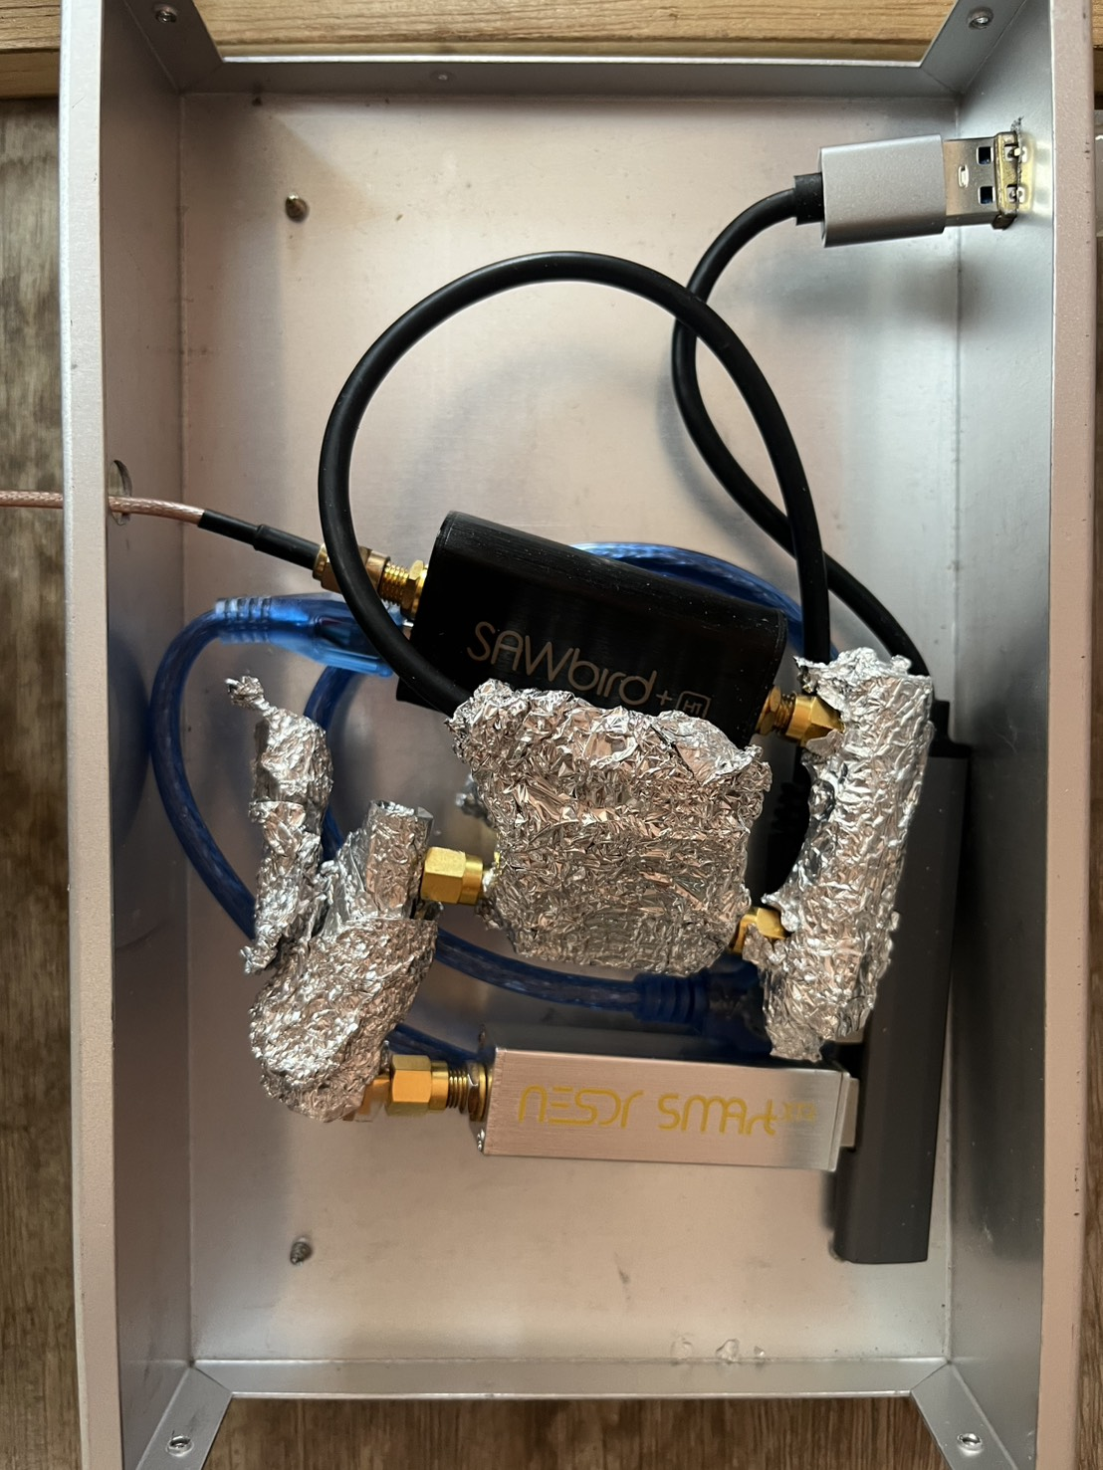

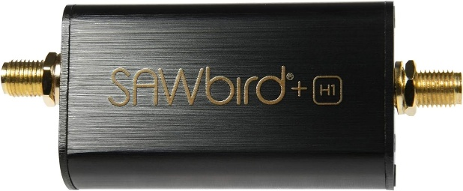
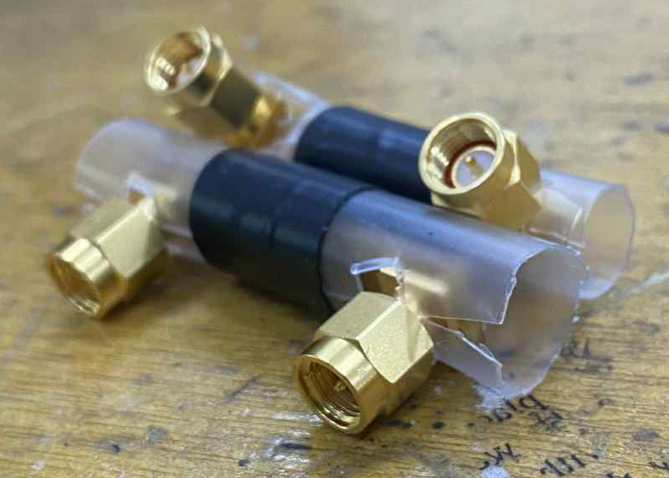
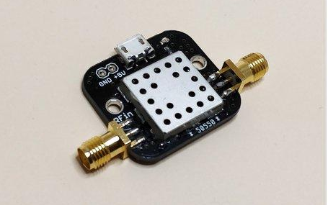
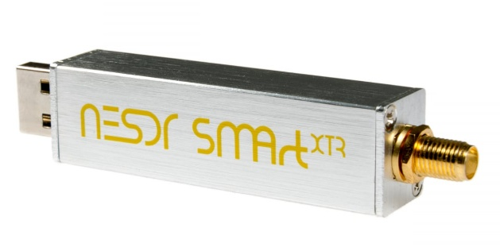


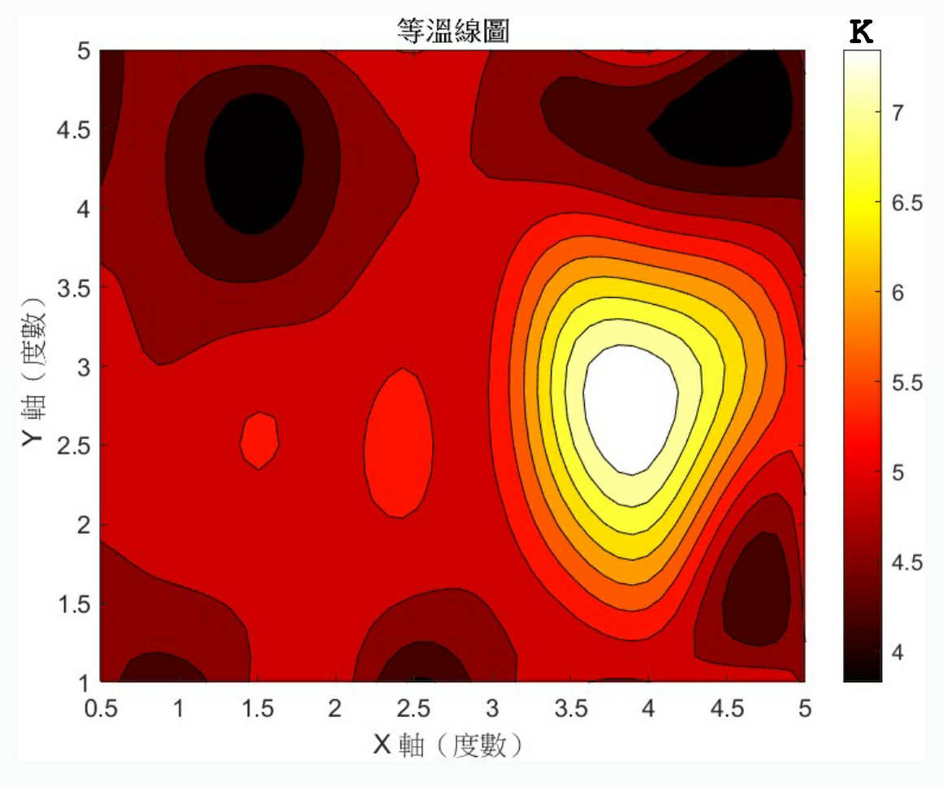
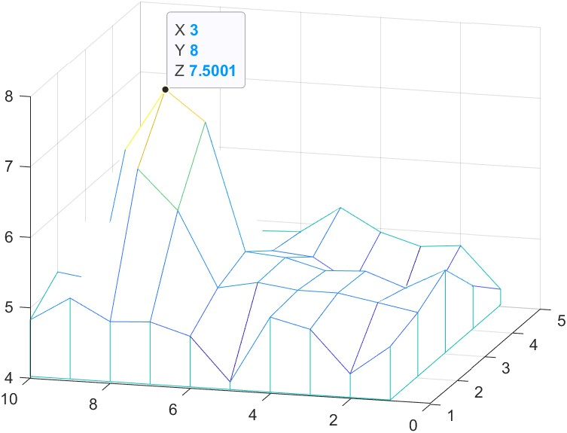



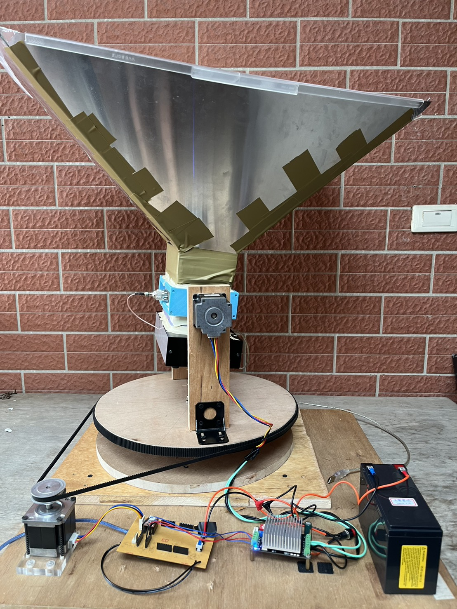
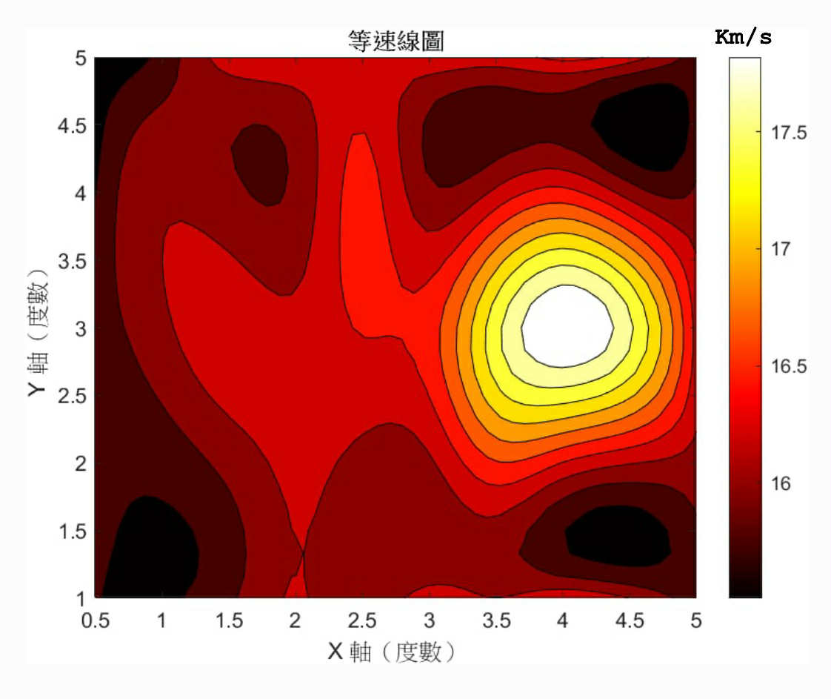
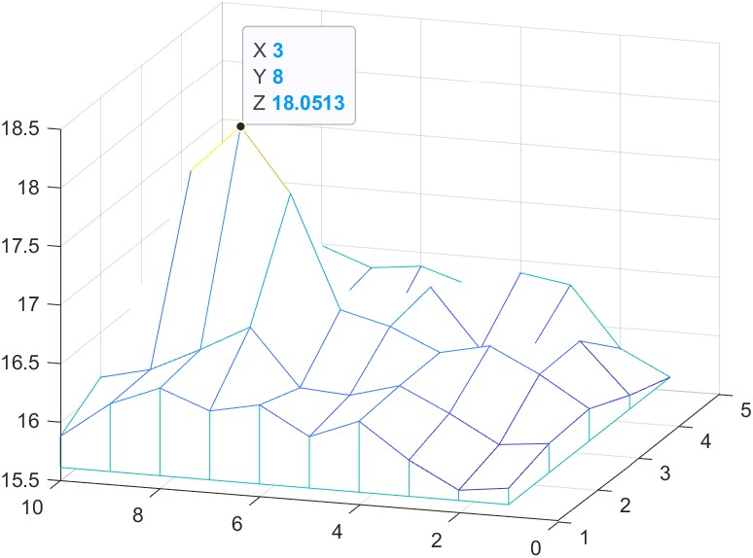
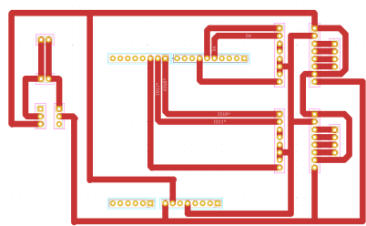
DIY 1420 MHz Radio Telescope
洪子宸 王廷睿 鄭丞竣
Abstract & Motivation
Department of Physics National Chung Cheng University
Hydrogen atoms in the universe produce characteristic electromagnetic waves at a frequency of 1420 MHz, which are called hydrogen lines. We use Arduino to control two stepper motors to control the horizontal and vertical rotation of the telescope. Finally, MATLAB is used to complete the final calculation.
Operation
Principle
Merak
We first used the APP to receive the signal, and the phone was placed on the bottom of the iron box with the opening facing the Ursa Major. Later, we switched to Matlab to run the graph in real time and used the program to find the peak for calculation.
To observe the relative distance between stars and me, we used the 1420MHz hydrogen line observation principle.When the high-energy hydrogen atom transitions back to the low-energy state, it releases electromagnetic waves with a wavelength of 21 cm (corresponding to a frequency of 1420 MHz). The average lifetime is about 10 million years, so we can observe its emission spectrum and calculate the Doppler effect.
Experimental design​
Unit : cm
5.3
30
8.35
33.95
5.24
56.17
8.35
30
5.3
39.08
5.24
40.7
5.24 cm
10.6 cm
Because we want to converge the signal onto the copper wire, we use a kerosene barrel as the middle part, and then use the size of the kerosene barrel to calculate the size of our aluminum plate. Then the signal we receive will be amplified twice by two LNAs and then to the SDR before reaching our laptop.
16.7 cm
Antenna
LNA1
DC block
LNA2
DC block
SDR
PC
Make the resistance as small as possible
NooelecSAWbird+ H1
226 PF
Hydrogen Line Pre-filtered LNA 1420 MHz w BIAS TEE
Nooelec SMARTee XTR Tuner E4000
Analysis results
The graph of temperature:
Doppler Shift:
dBm convert to watts:
$$\frac{p_{w}}{1.38×{10}^{−23}×{10}^{6}}$$
Main coding:​
The video of operation
start
fopen(Arduino)
Setting SDR parameters
Run the loop
Matlab confirm
Horizontal
motor clockwise
Arduino gets "a"
Output a, b, c​
The graph of velocity:
Horizontal motor reverse
Arduino gets "b"
Vertical motor clockwise
Arduino gets "c"
Run the loop
Storage of data
fclose(Arduino)
finish
Belt size:
 | Specification | Length | Number of teeth
Main belt | 1500-3M | 1500 | 500
Auxiliary belt | 1233-3M | 1233 | 411
Circuit Board:
Conclusion
Note: The left side is the graph drawn after interpolation of our original data, and the right side is the graph drawn directly with the original data.
power supply
The conclusion is that we rotate horizontally 9 steps, each step is 0.5 degrees, and vertically 4 steps are 1 degree. After we get the signal, we move slightly to the lower left and then start measuring. The maximum speed is 18 km/s and the temperature is 7.5 degrees. It is not much different from the theoretical value we refer to, so we think it is of reference value. This proves that our research direction is correct. If we continue to study it in the future, we may be able to measure more interesting stars.
Reference
capacitance
1. Pyramidal Horn Calculator, https://www.microwavetools.com/pyramidal-horn-calculator/
2. The hydrogen 21-cm line and its applications to radio astrophysics, L Liu, C Chronopoulos, Massachusetts Institute of Technology (2008)
3. A radio continuum survey of the southern sky at 1420 MHz, P. Reich, J. C. Testori, and W. Reich, A&A 376, 861-877 (2001)
switch
A4988*2
Arduino

