Slide 1
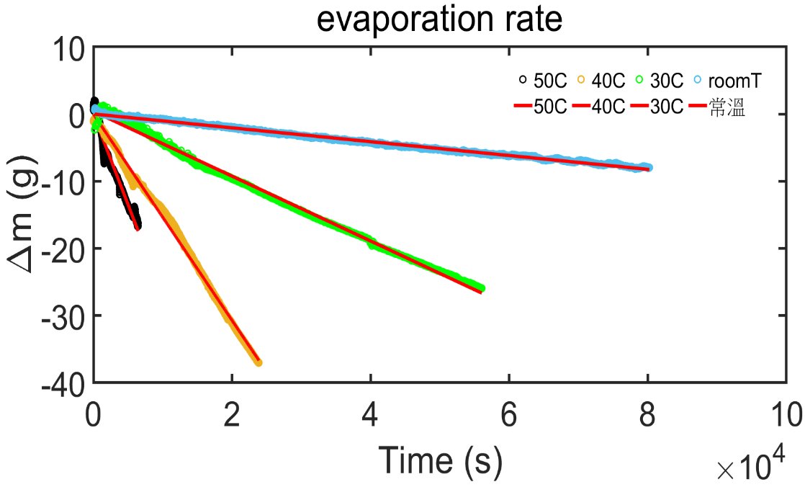
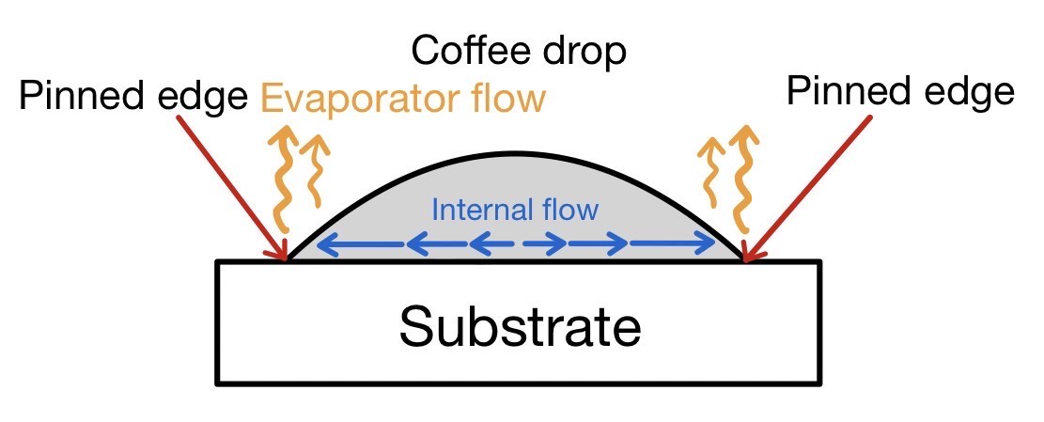





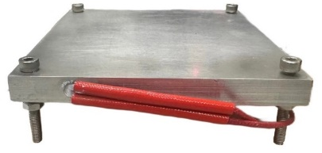


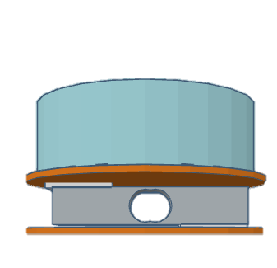

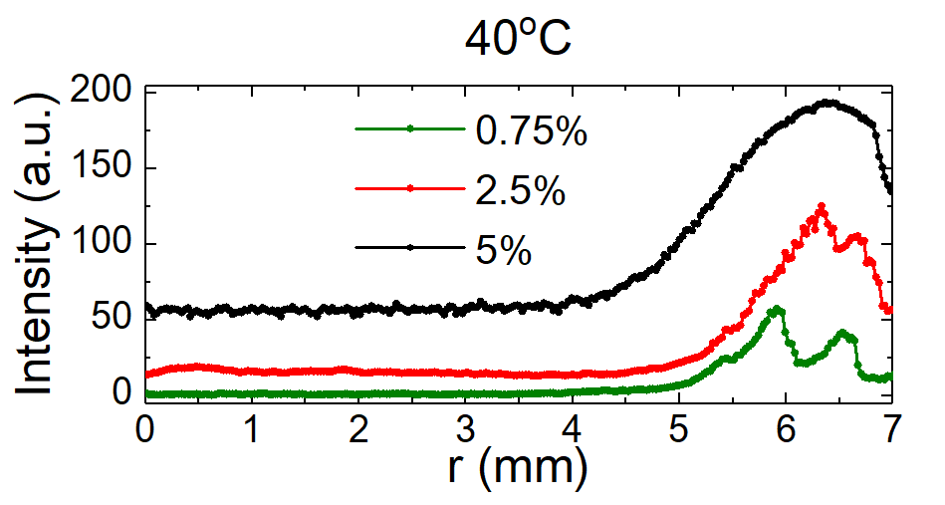
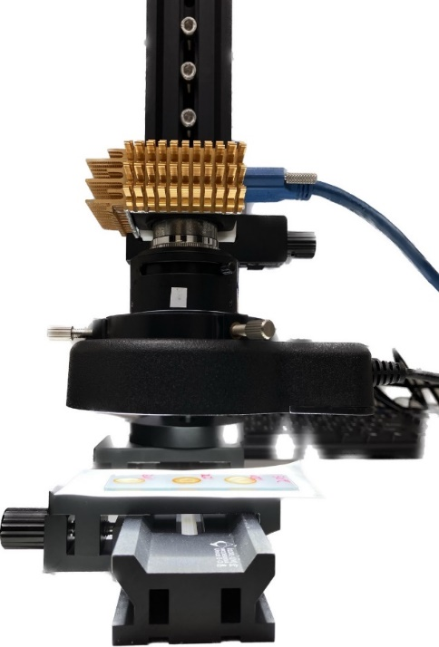
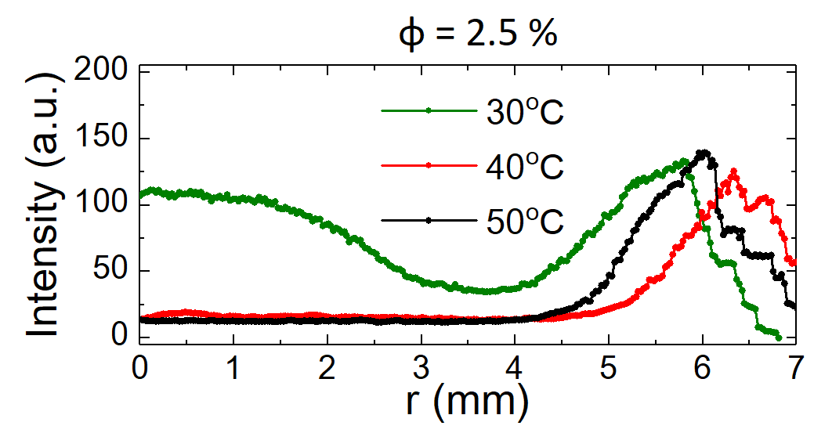
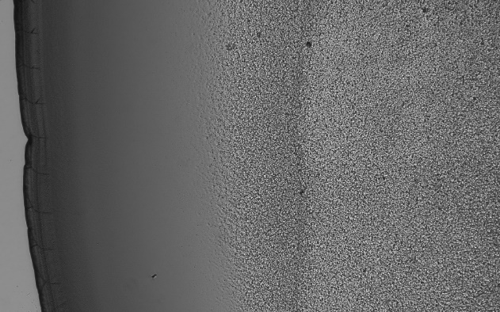
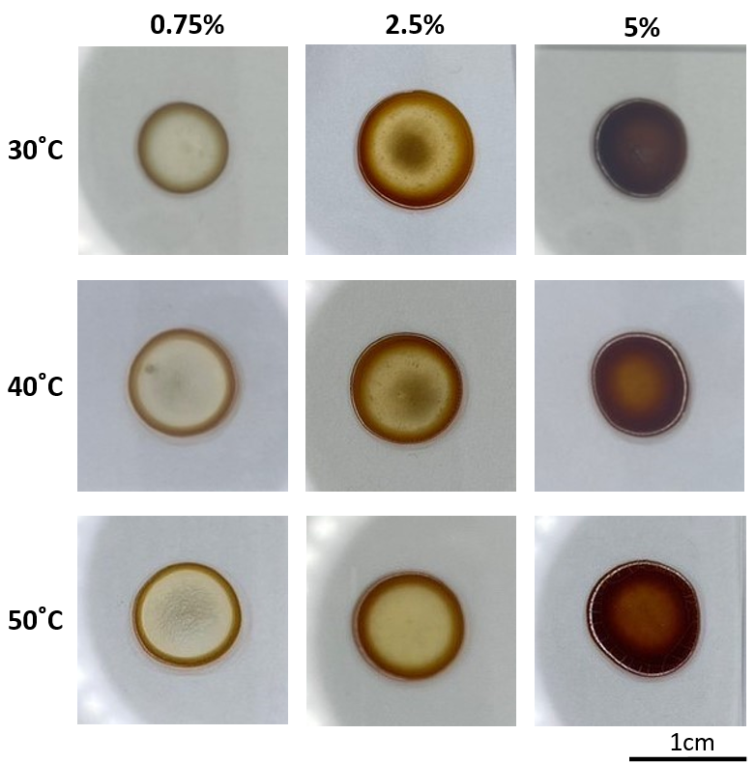
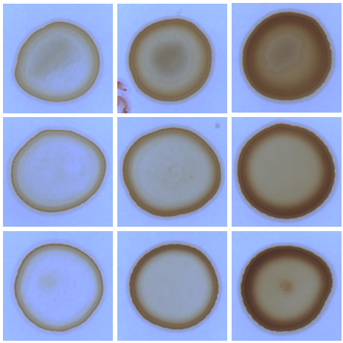
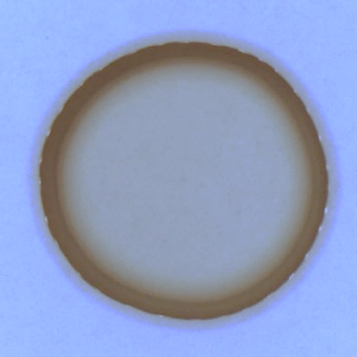
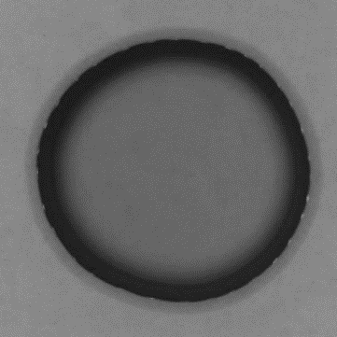
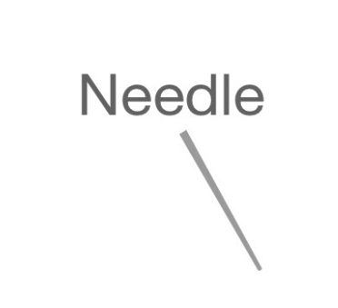
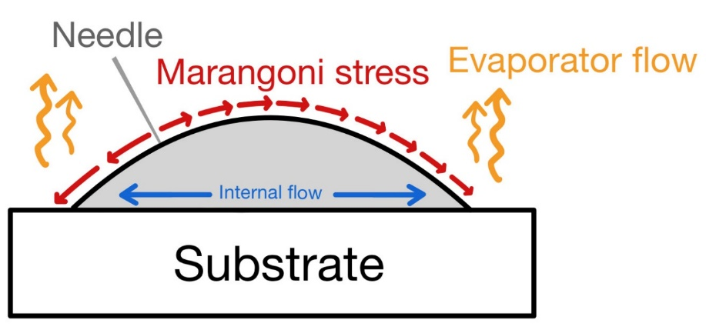
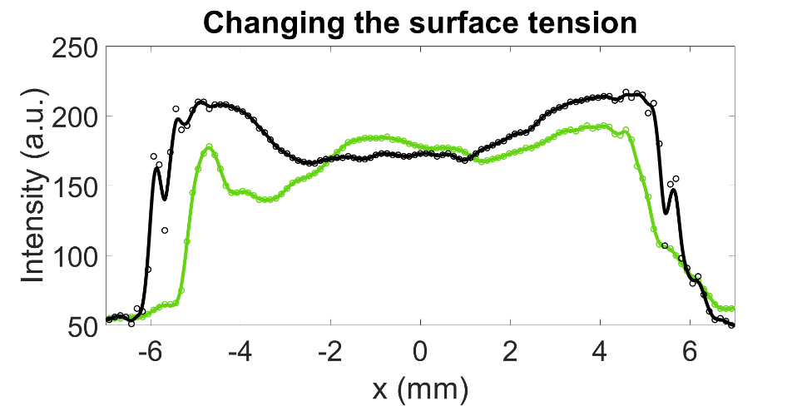
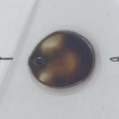
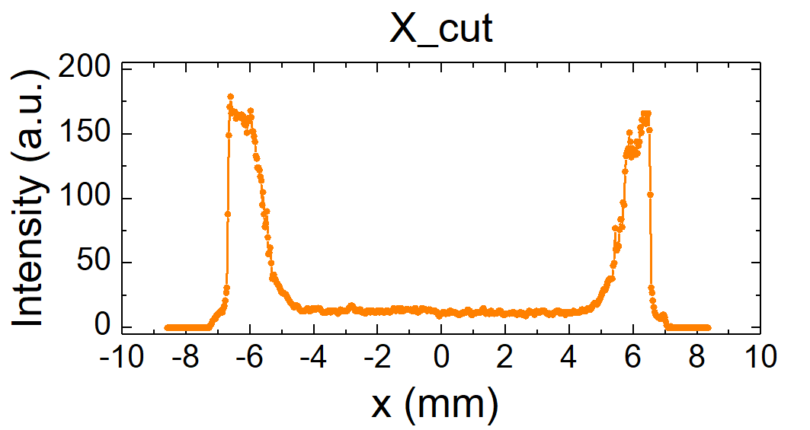
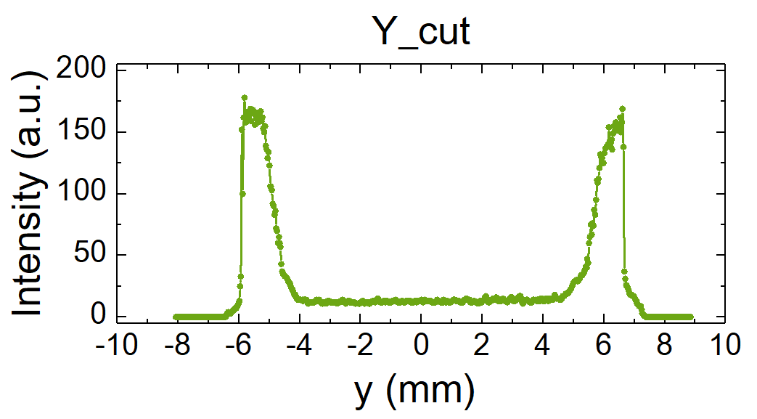



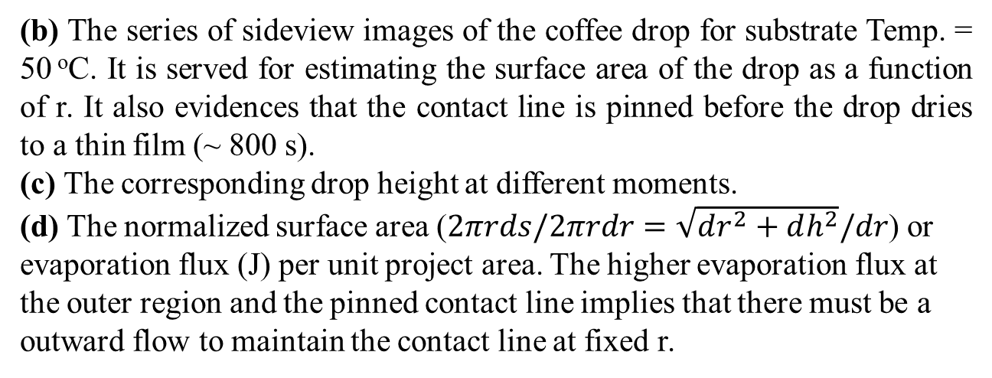
An experimental study of coffee ring pattern
國立中正大學 洪啟鈞 楊宗于 吳敏綺 陳妍伊
Motivation
The evaporation of coffee drop
The coffee ring, characterized by denser particle accumulation at the outer region, is a common and robust phenomenon in our daily life. Thus, we experimentally investigate how the coffee ring pattern forms in response to the evaporation-induced outward flow at different evaporation rates. In addition, we also extend to study the pattern change under the cooperation of evaporation and Marangoni stress.
(a)
Temperature (ºC) | R.T. | 30 | 40 | 50
Evaporation rate, ε (μg/s·cm²) | 1.75 | 8.92 | 26.75 | 436.90
Background
50 ºC
R. T.
(a) Once a petri dish of coffee is placed on a thermostat, the evaporation rate is acquired from the mass changing rate (Δm/Δt).
Once a coffee drop is deposited on a glass slide, it forms a spherical cap with the pinned edge.
40 ºC
30 ºC
  Faster evaporation at the outer region
  Outward flow to maintain the pinned edge
  Coffee ground is carried to the edge
  Darker coffee strain at the outer region
Side-view
Setup and method
(b)
(c)
(d)
Thermostat
MCU
PWM Out
Heater
Time = 0 s
A closed loop PID controlled heating plate
Heater : 12V40W
Temperature Sensor : K-type thermo couple
MCU : REX-C100FK02, CKC Instrument Inc.
Hot plane
200 s
(b) The series of sideview images of the coffee drop for substrate Temp. = 50 ºC. It is served for estimating the surface area of the drop as a function of r. It also evidences that the contact line is pinned before the drop dries to a thin film (~ 800 s).
(c) The corresponding drop height at different moments.
(d) The normalized surface area ($2πrds/2πrdr=\sqrt{dr^{2}+dh^{2}}/dr$) or evaporation flux (J) per unit project area. The higher evaporation flux at the outer region and the pinned contact line implies that there must be a outward flow to maintain the contact line at fixed r.
Temperature sensor
400 s
Heater
Hot plane
PID
800 s
Evaporation rate and micro-balance
1600 s
1mm
The evaporation rate is read from mass changing rate in time
Micro-balance: HX711 + 1000 g load cell
8.45 cm (inner diameter) petri dish
MCU：Arduino
HX711
The effect of coffee concentration
The plot of the inverted intensity profile for different coffee concentrations by fixing the substrate temperature at 40 ºC. It evidences that the phenomenon of dense accumulation at the edge of the contact line is robust over wide range of concentration. For higher concentration, the peak slightly shifted to the outer region is mainly due to the increased wettability (wetting area).
Petri dish
LED backlight
Camera
Load cell
Substrate, material and imaging system
Slide glass
Coffee drop: coffee power (Moccona) + RO water
Coffee concentration (w.t. %) : 0.75 ~ 5%
LED backlight
Camera: Pointgrey, CM3-U3-13Y3C-CS
The effect of substrate temperature
Slide glass
(a)
(b)
Coffee ring
(a)
The coffee ring pattern
(a)
Φ
(c)
1 mm
(b)
(a) On the other side, by fixing the concentration, different substrate temperatures are also tested. It again shows that the accumulation at the edge always exists. It is worth noticing that, the case with 30 ⁰C substrate temperature, the lower evaporation flux associates with weaker outward flow. It is not sufficient to carry the larger coffee particle to the outer area, hence another accumulation appears at the center region.
(b) The microscope image of coffee ring pattern for 30 ⁰C case, where the outward flow is not sufficient to carry the larger particle to the outer region, while the fine particles are driven to the edge.
X-cut
The Effect of Surface Tension
(a)
(b)
(c)
T
Y-cut
$$γ_{0}$$
$$γ_{−}$$
$$γ_{−}$$
$$γ_{0}$$
(c)
(d)
1cm
w/ surfactant
w/o surfactant
In order to test the formation mechanism, a perturbation is applied by added surfactant on the drop surface through a needle as labelled in (a). The surface tension at the needle side is decreased (γ-). Hence, the Marangoni stress is induced as illustrated in (b). The corresponding profile is shown in (c).
Conclusion
(a) The overall tendency of coffee ring patterns with different coffee concentrations (Φ) and substrate temperature (T).
(b) The coffee strain density is quantified by the intensity of the image. The darker region has a denser accumulation of coffee particle, and vice versa. Thus, the raw image (upper panel) is first converted to inverted grayscale image (lower panel).
(c) and (d) The inverted intensity profiles of the coffee strain along the x and y axis as labelled in (b), respectively. It clearly shows that the outer region is indeed darker. Moreover, the pattern is isotropic and symmetry to x or y = 0. Thus, the further analysis is focused on the radial direction.
We experimentally investigate the coffee ring pattern at different coffee concentrations and substrate temperatures.
The formation of coffee ring, dense accumulation at edge of the drop, is due to the uneven evaporation induced outward flow, which is robust and universal over wide range of concentration and substrate temperature.
The above mechanism is further verified by applying a Marangoni stress by adding surfactant on the drop surface.
Reference
[1] R. D. Deegan et al., Nature 389, 827 (1997)
[2] P.G. de Gennes, Capillarity and Wetting Phenomena, Springer (2004)

